Slide 1

19ECC01 – COMPUTER ARCHITECTURE AND ORGANIZATION

Slide 2
UNIT I - COMPUTING ELEMENTS & DATA REPRESENTATION
Elements of Computers and its Limitations
System Design
Gate Level, Register Level and Processor Level Components & Design
CPU Organization
Data Representation
Fixed Point Numbers
Floating Point Numbers
Instruction Formats
Instruction Types
Addressing Modes

Slide 3
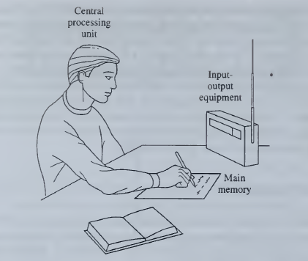
UNIT I - COMPUTING ELEMENTS & DATA REPRESENTATION
Elements of Computers and its Limitations

Slide 4
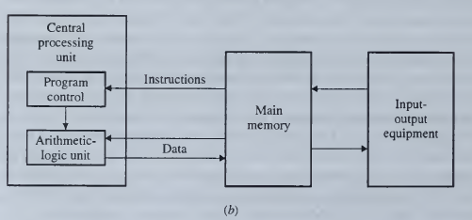
UNIT I - COMPUTING ELEMENTS & DATA REPRESENTATION
Elements of Computers and its Limitations

Slide 5
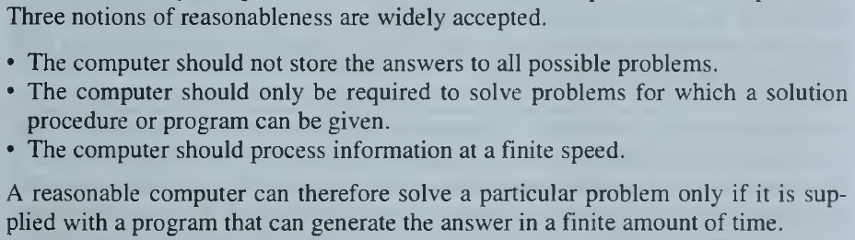
UNIT I - COMPUTING ELEMENTS & DATA REPRESENTATION
Elements of Computers and its Limitations

Slide 6
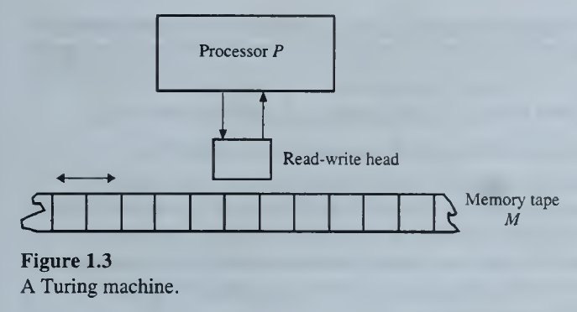
UNIT I - COMPUTING ELEMENTS & DATA REPRESENTATION
Elements of Computers and its Limitations

Slide 7
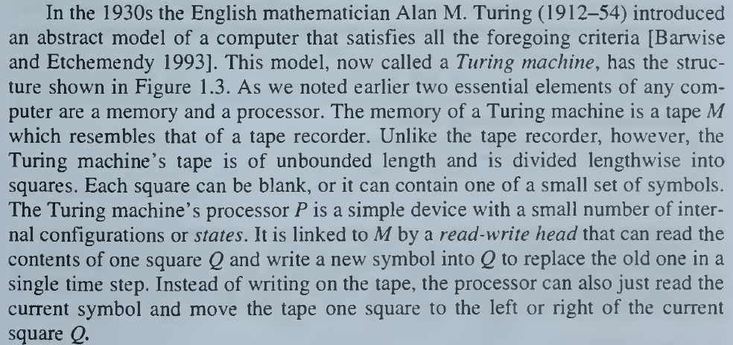
UNIT I - COMPUTING ELEMENTS & DATA REPRESENTATION
Elements of Computers and its Limitations

Slide 8

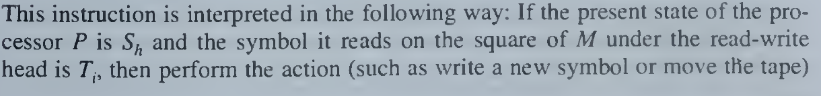
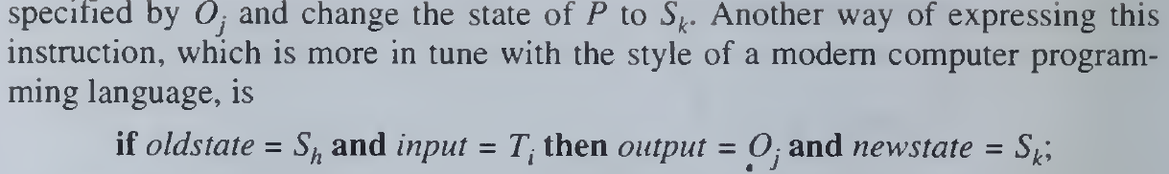
UNIT I - COMPUTING ELEMENTS & DATA REPRESENTATION
Elements of Computers and its Limitations

Slide 9
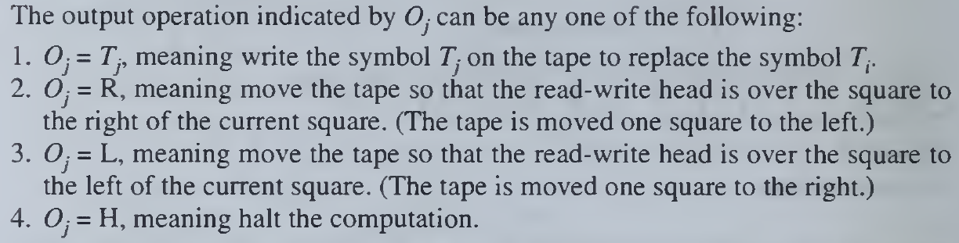
UNIT I - COMPUTING ELEMENTS & DATA REPRESENTATION
Elements of Computers and its Limitations

Slide 10
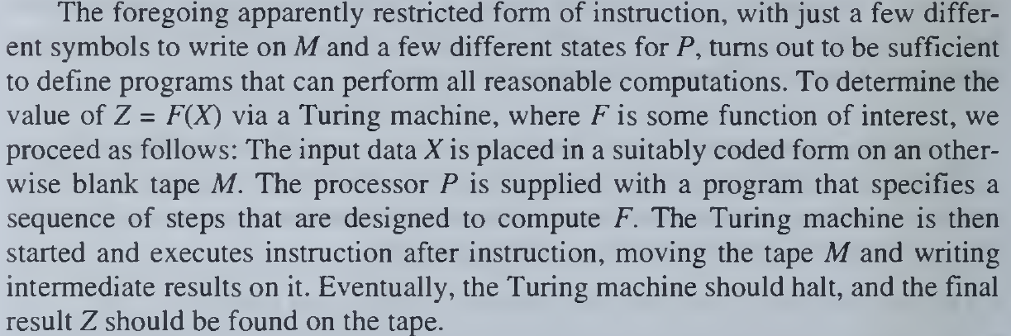
UNIT I - COMPUTING ELEMENTS & DATA REPRESENTATION
Elements of Computers and its Limitations

Slide 11
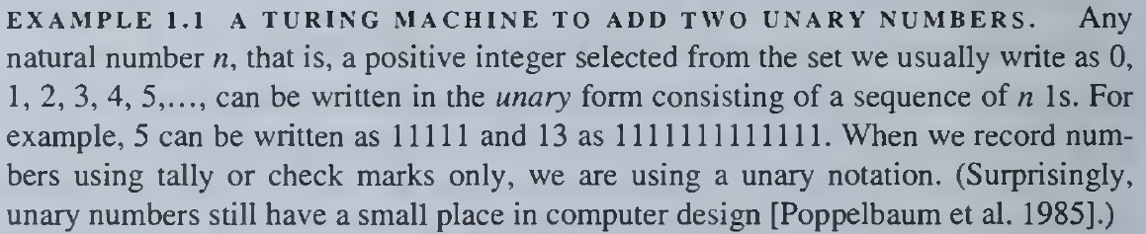
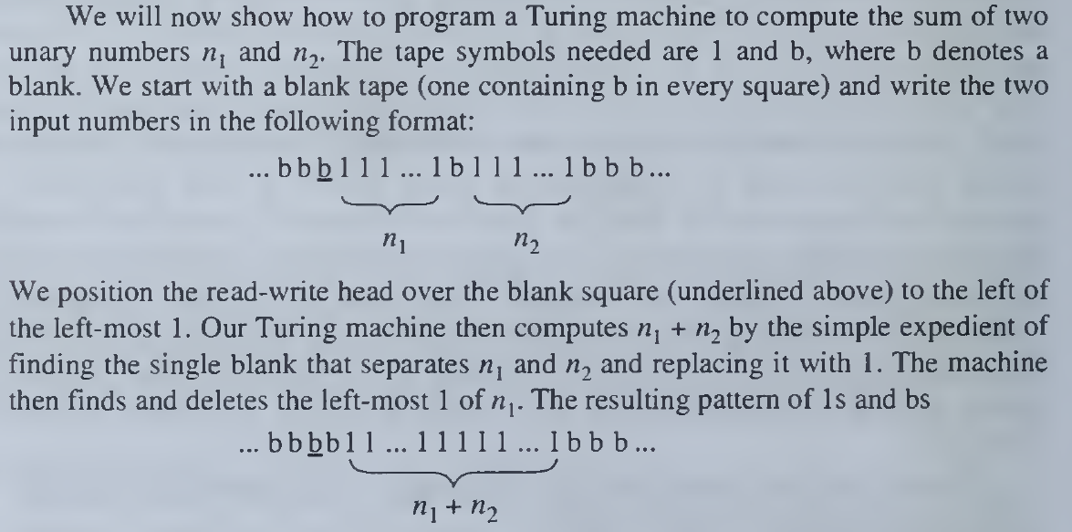
UNIT I - COMPUTING ELEMENTS & DATA REPRESENTATION
Elements of Computers and its Limitations

Slide 12
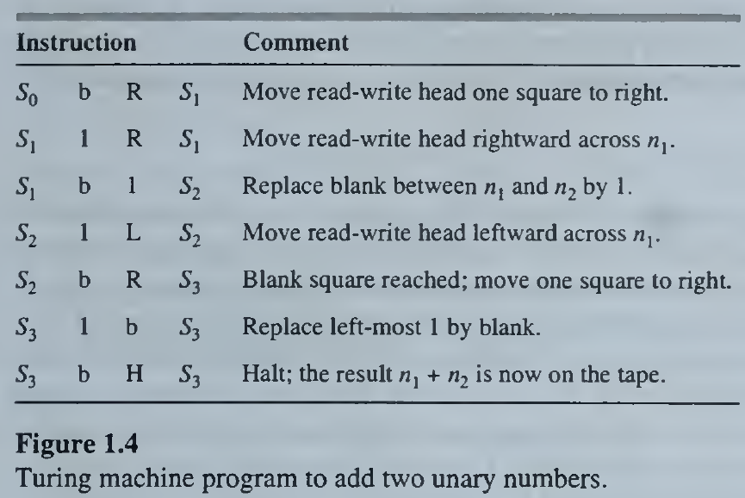
UNIT I - COMPUTING ELEMENTS & DATA REPRESENTATION
Elements of Computers and its Limitations
ts < 30 (t= no. of tape symbols; s=no. of states)
Former of RISC Processor – Turing Machine

Slide 13
UNIT I - COMPUTING ELEMENTS & DATA REPRESENTATION
Limitations of Computers
Unsolvable/Undecidable Problems
Intractable Problems
Speed Limitations

Slide 14
UNIT I - COMPUTING ELEMENTS & DATA REPRESENTATION
Limitations of Computers
Unsolvable/Undecidable Problems
Goldbach's conjecture
Which states that every even integer greater than 2 is the sum of exactly two prime numbers.
8 = 3 + 5 and 108 = 37 + 71 .
It is not yet known if the conjecture is true for every even integer, nor is any reasonable procedure known to determine whether the conjecture is true. The number of even integers is infinite, so a complete or exhaustive examination of all even integers and their prime factors is not feasible.

Slide 15
UNIT I - COMPUTING ELEMENTS & DATA REPRESENTATION
Limitations of Computers
Unsolvable/Undecidable Problems
2. n arbitrary polynomial equation
the Turing machine halting problem as this particular problem is called, is also undecidable.
A common and costly error made by inexperienced computer programmers is to write programs that contain infinite loops and therefore fail to halt under certain input conditions. It would be useful to have a debugging program that could determine whether any given program contains an infinite loop.

Slide 16
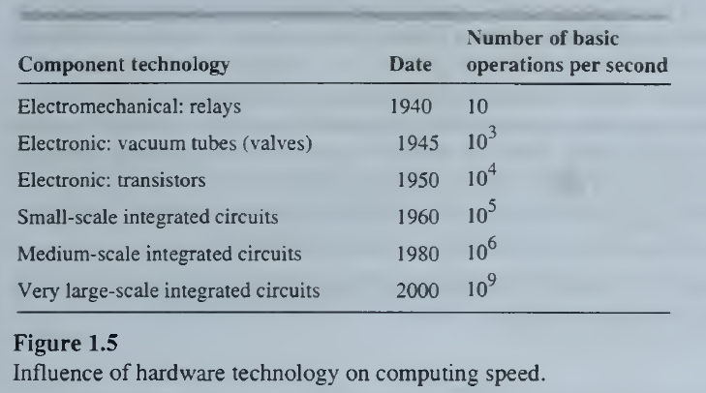
UNIT I - COMPUTING ELEMENTS & DATA REPRESENTATION
Limitations of Computers
2. Intractable problems
Real (finite-state) computers can solve most computational problems to an acceptable degree of accuracy.
A computer of reasonable size and cost solve a given problem in a reasonable amount of time is tractable; otherwise, it is intractable..

Slide 17
UNIT I - COMPUTING ELEMENTS & DATA REPRESENTATION
Limitations of Computers
2. Intractable problems
Traveling salesman problem
Here the goal is also to make a tour, this time by car or plane through a given set of n cities, and eventually return to the starting point. The distance between each pair of cities is known, and the problem is to determine a tour that minimizes the total distance traveled..
An intractable problem can be solved exactly in a reasonable amount of time only when its size n is below some maximum value n_{MAX}. The value of n_{MAX} depends both on the problem itself and on the speed of the computers available to solve it. It might be expected that computer speeds could be increased to make n_{MAX} any desired value.

Slide 18
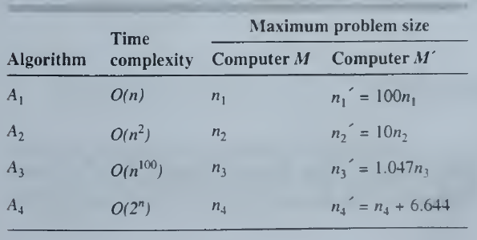
UNIT I - COMPUTING ELEMENTS & DATA REPRESENTATION
Limitations of Computers
3. Speed limitations
An algorithm A has time complexity of order f(n), denoted o(f(n)).
The function f(n) therefore indicates the rate at which the computing time that A needs to obtain a solution grows with the problem size n.

Slide 19
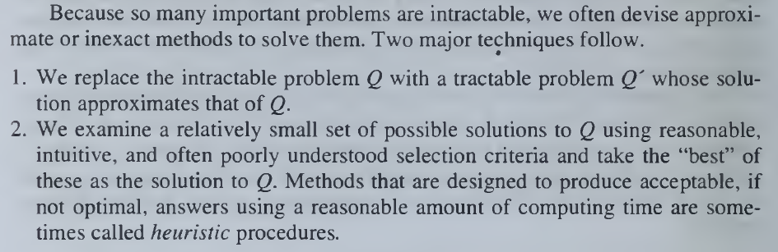
UNIT I - COMPUTING ELEMENTS & DATA REPRESENTATION
Limitations of Computers

Slide 20
UNIT I - COMPUTING ELEMENTS & DATA REPRESENTATION
SYSTEM DESIGN
A computer is an example of a system, which is defined informally as a collection— often a large and complex one—of objects called components, that are connected to form a coherent entity with a specific function or purpose.
The function of the system is determined by the functions of its components and how the components are connected.
The mapping can be expressed formally by a mathematical function f from A to B.
If f maps element a of A onto element b of B, we write b = f(a) or b := f(a).

Slide 21
UNIT I - COMPUTING ELEMENTS & DATA REPRESENTATION
System Representation
Graphical Representation:
A useful way of modeling a system is a graph. A (directed) graph consists of a set of objects V = {v₁,v₂,...,v_{n},} called nodes or vertices and a set of edges E whose members are (ordered) pairs of nodes taken from the set {(v_{l},v₂), (V!,v3),...,(v_{n-1},v_{n})}of all such pairs. The edge e = (v_{i},v_{j} joins or connects node v_{i} to node v_{j}.
Block Diagram Representation:
Set of information processing components C and a set of lines S that carry information signals between components. In modeling the system by a graph G, we associate C with the nodes of G and S with the edges of G; the resulting graph is often called a block diagram. This name comes from the fact that it is convenient to draw each node (component) as a block or box in which its name and/or its function can be written.

Slide 22
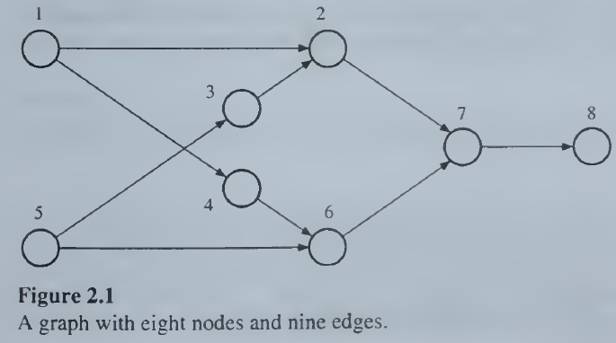
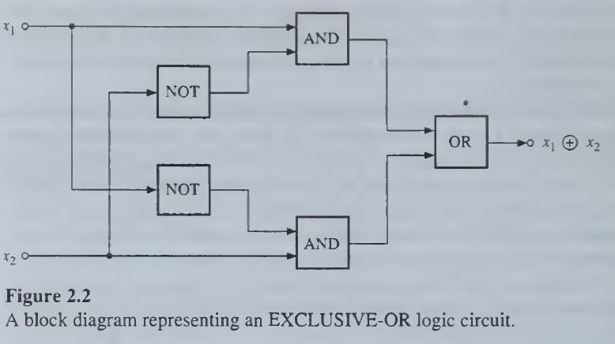
UNIT I - COMPUTING ELEMENTS & DATA REPRESENTATION
System Representation

Slide 23
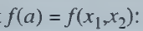
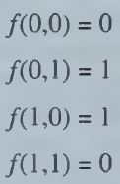
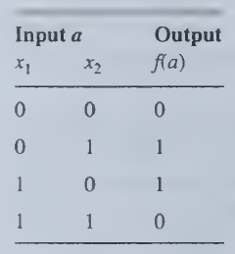
UNIT I - COMPUTING ELEMENTS & DATA REPRESENTATION
Structure versus behavior
Two central properties of any system are its structure and behavior.
We define the structure of a system as the abstract graph consisting of its block diagram with no functional information.
A behavioral description, on the other hand, enables one to determine for any given input signal a to the system, the corresponding output f(a).
We define the function/to be the behavior of the system.
In general, a block diagram conveys structure rather than behavior.

Slide 24
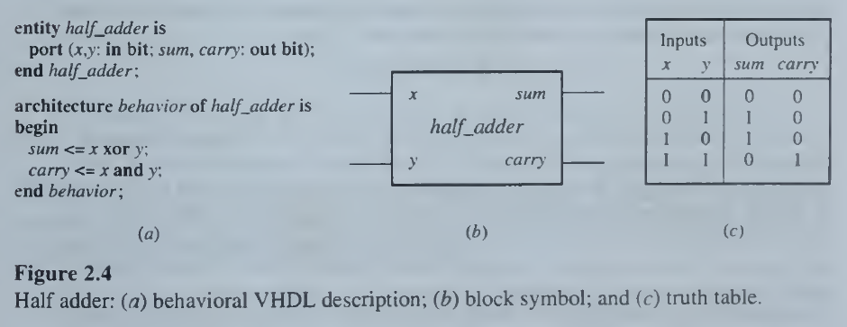
UNIT I - COMPUTING ELEMENTS & DATA REPRESENTATION
Hardware Description Languages

Slide 25
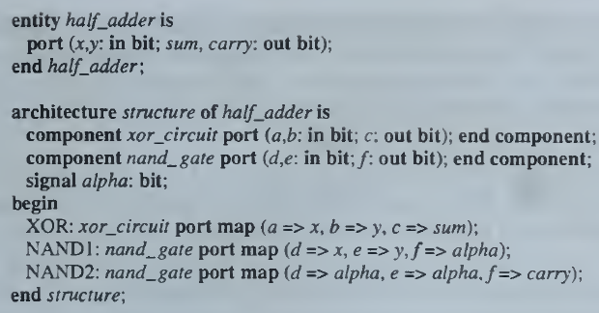
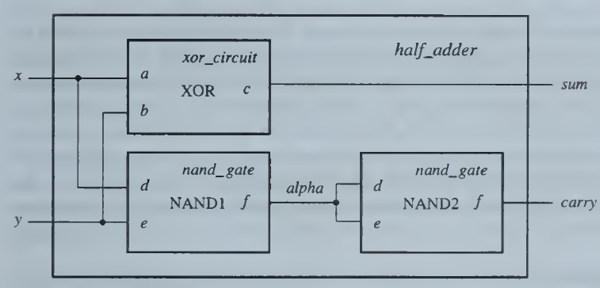
UNIT I - COMPUTING ELEMENTS & DATA REPRESENTATION
Hardware Description Languages

Slide 26
UNIT I - COMPUTING ELEMENTS & DATA REPRESENTATION
Design Process
Given a system's structure, the task of determining its function or behavior is termed analysis.
The converse problem of determining a system structure that exhibits a given behavior is design or synthesis.
Design problem:
Given a desired range of behavior and a set of available components, determine a structure (design) formed from these components that achieves the desired behavior with acceptable cost and performance.
Typical requirements:
Minimize cost as measured by the cost of manufacture
Maximize performance as measured by the speed of operation.
High reliability, low power consumption, and compatibility with existing systems.
Complexity and novelty of the design.

Slide 27
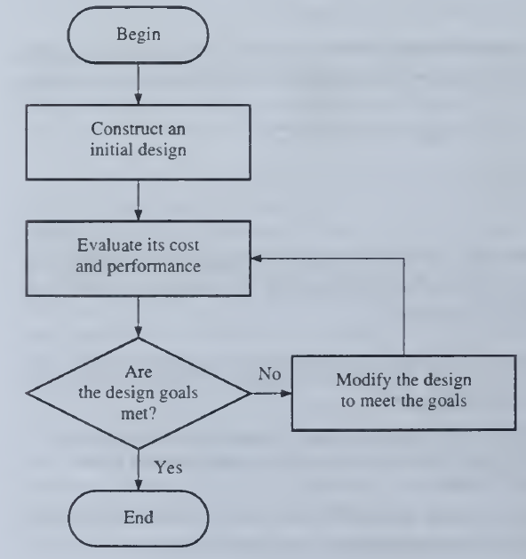
UNIT I - COMPUTING ELEMENTS & DATA REPRESENTATION
Design Process
Computer-aided design

Slide 28
UNIT I - COMPUTING ELEMENTS & DATA REPRESENTATION
Design Process
Computer-aided design
CAD editors or translators convert design data into forms such as HDL descriptions or schematic diagrams, which humans, computers, or both can efficiently process.
Simulators create computer models of a new design, which can mimic the design's behavior and help designers determine how well the design meets various performance and cost goals.
Synthesizers automate the design process itself by deriving structures that implement all or part of some design step.

Slide 29
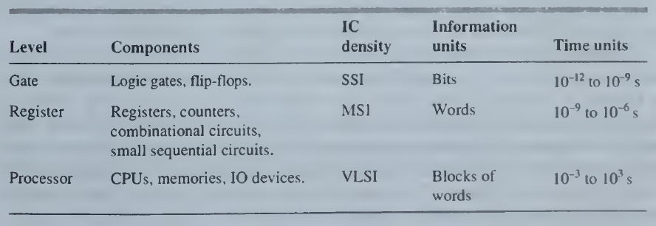
UNIT I - COMPUTING ELEMENTS & DATA REPRESENTATION
Design Process
Design Levels
The processor level, also called the architecture, behavior, or system level.
The register level, also called the register-transfer level (RTL).
The gate level, also called the logic level.

Slide 30
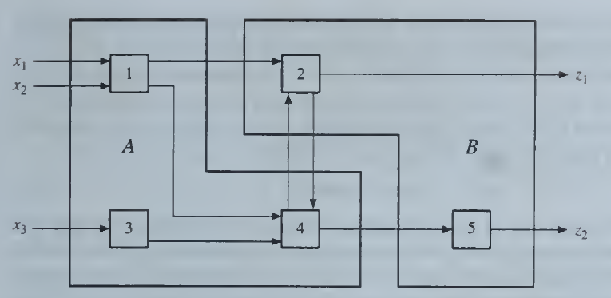
UNIT I - COMPUTING ELEMENTS & DATA REPRESENTATION
Design Process
System Hierarchy
Top-down Approach
Bottom-up Approach

Slide 31
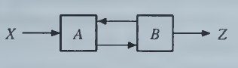
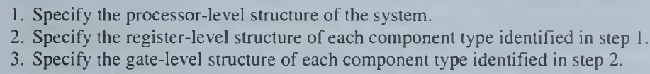
UNIT I - COMPUTING ELEMENTS & DATA REPRESENTATION
Design Process
System Hierarchy

Slide 32
UNIT I - COMPUTING ELEMENTS & DATA REPRESENTATION
GATE LEVEL DESIGN
Gate-level (logic) design is concerned with processing binary variables whose possible values are restricted to the bits (binary digits) and 1 .
The design components are logic gates, which are simple, memoryless processing elements, and flip-flops, which are bit-storage devices.

Slide 33
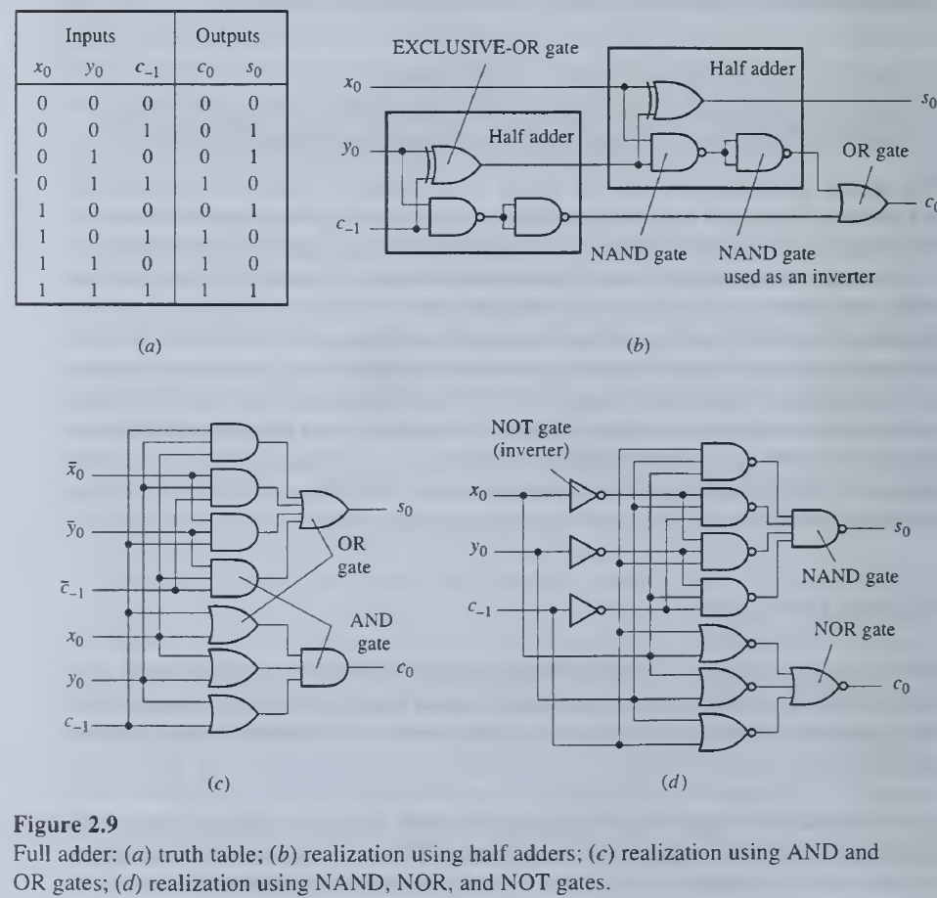
UNIT I - COMPUTING ELEMENTS & DATA REPRESENTATION
GATE LEVEL DESIGN
Combinational Circuits

Slide 34
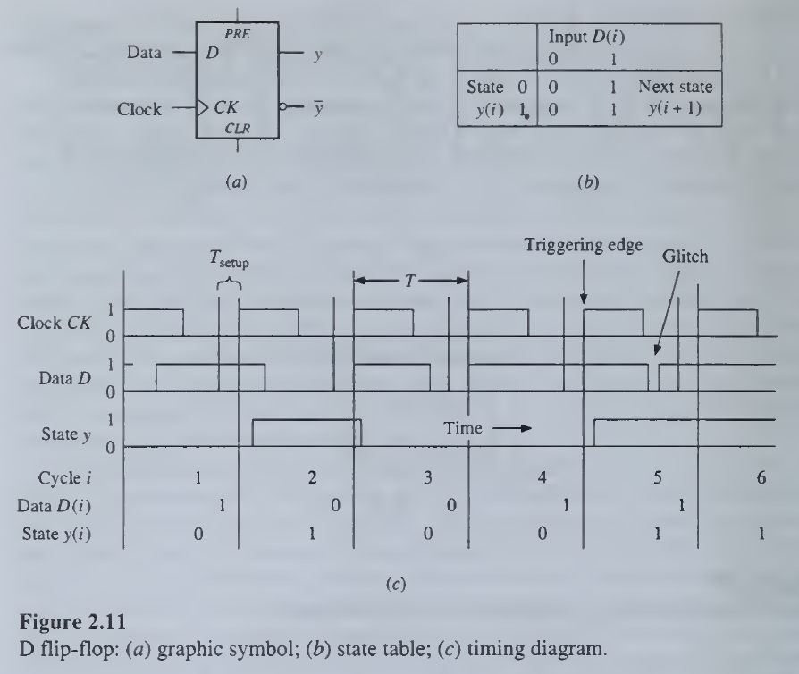
UNIT I - COMPUTING ELEMENTS & DATA REPRESENTATION
GATE LEVEL DESIGN
Combinational Circuits

Slide 35
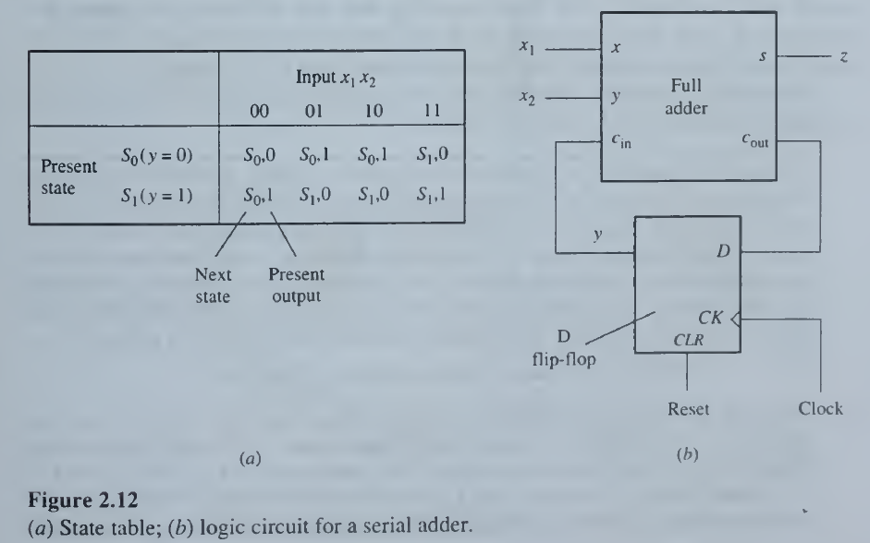
UNIT I - COMPUTING ELEMENTS & DATA REPRESENTATION
GATE LEVEL DESIGN
Sequential Circuits

Slide 36
UNIT I - COMPUTING ELEMENTS & DATA REPRESENTATION
REGISTER LEVEL DESIGN
The register or register-transfer level, related information bits are grouped into ordered sets called words or vectors.
Register-level circuits are composed of word-oriented devices.
The key sequential component, which gives this level of abstraction its name, is a (parallel) register, a storage device for words.
Other common sequential elements are shift registers and counters.

Slide 37
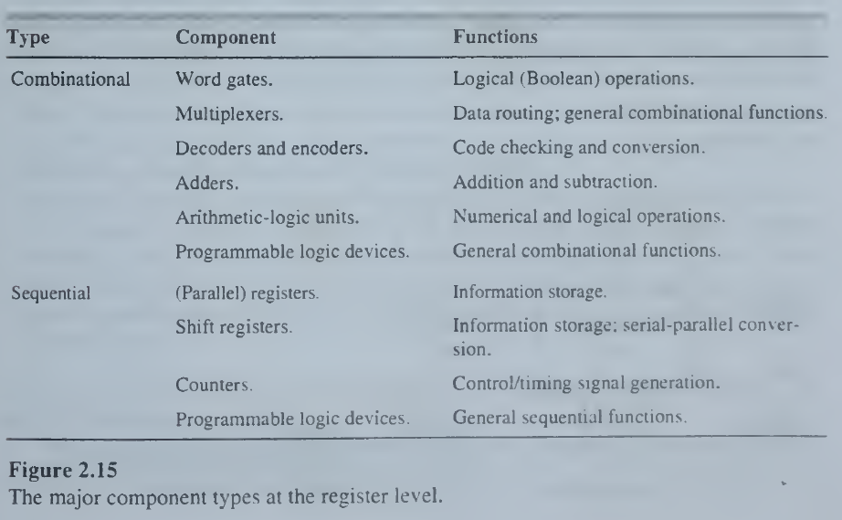
UNIT I - COMPUTING ELEMENTS & DATA REPRESENTATION
REGISTER LEVEL DESIGN

Slide 38
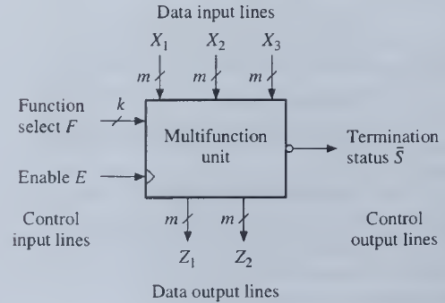
UNIT I - COMPUTING ELEMENTS & DATA REPRESENTATION
REGISTER LEVEL DESIGN
Generic block representation of a register-level component

Slide 39
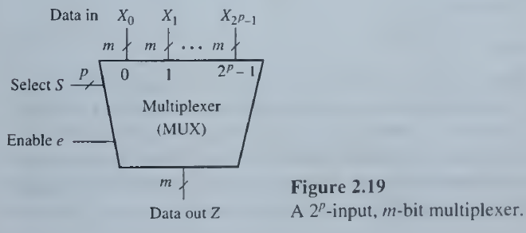
UNIT I - COMPUTING ELEMENTS & DATA REPRESENTATION
REGISTER LEVEL DESIGN
Multiplexers as function generators
Multiplexers have the interesting property that they can compute any combinational function and so form a type of universal logic generator.

Slide 40
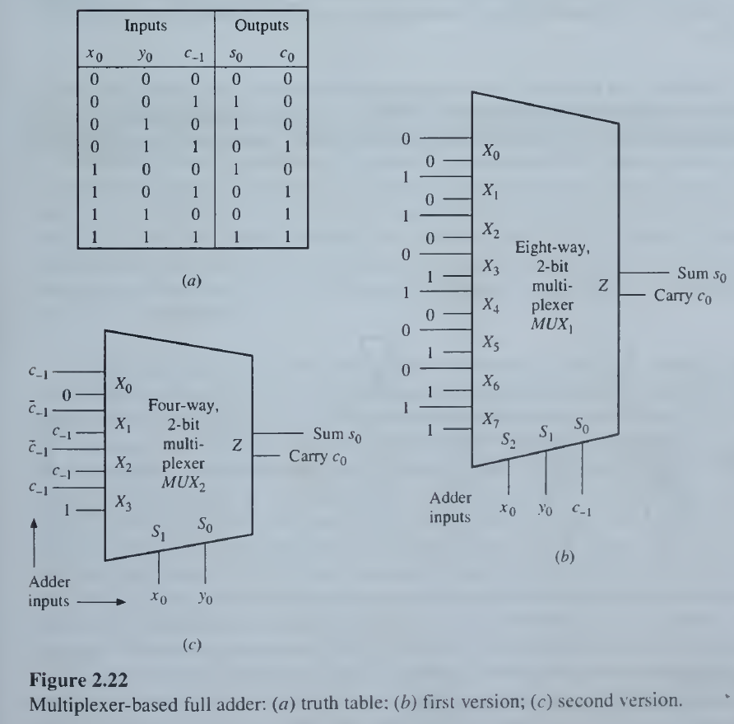
UNIT I - COMPUTING ELEMENTS & DATA REPRESENTATION
REGISTER LEVEL DESIGN
Multiplexers based FULL ADDER

Slide 41
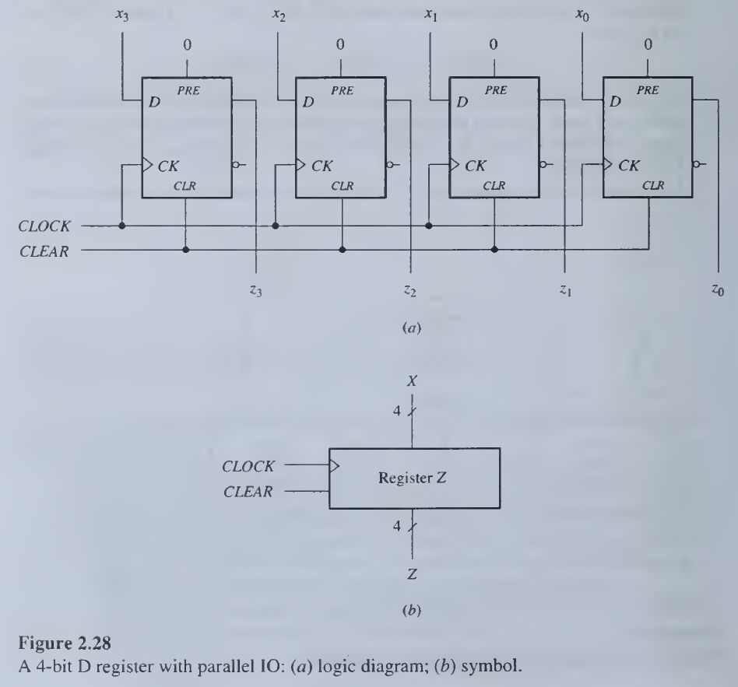
UNIT I - COMPUTING ELEMENTS & DATA REPRESENTATION
REGISTER LEVEL DESIGN

Slide 42
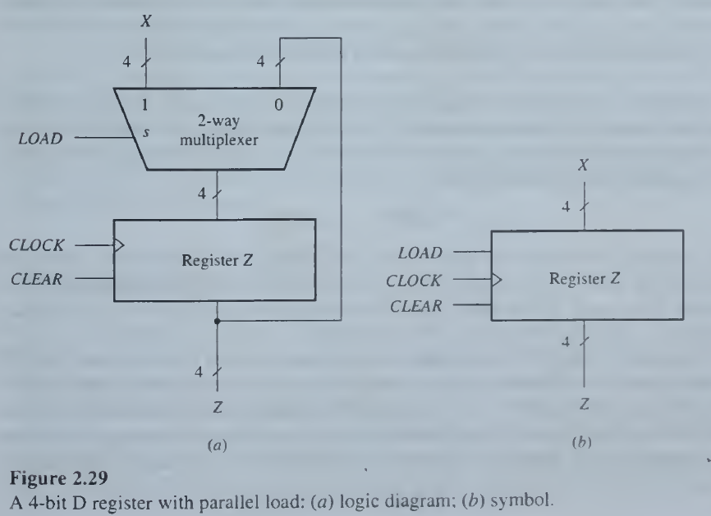
UNIT I - COMPUTING ELEMENTS & DATA REPRESENTATION
REGISTER LEVEL DESIGN

Slide 43
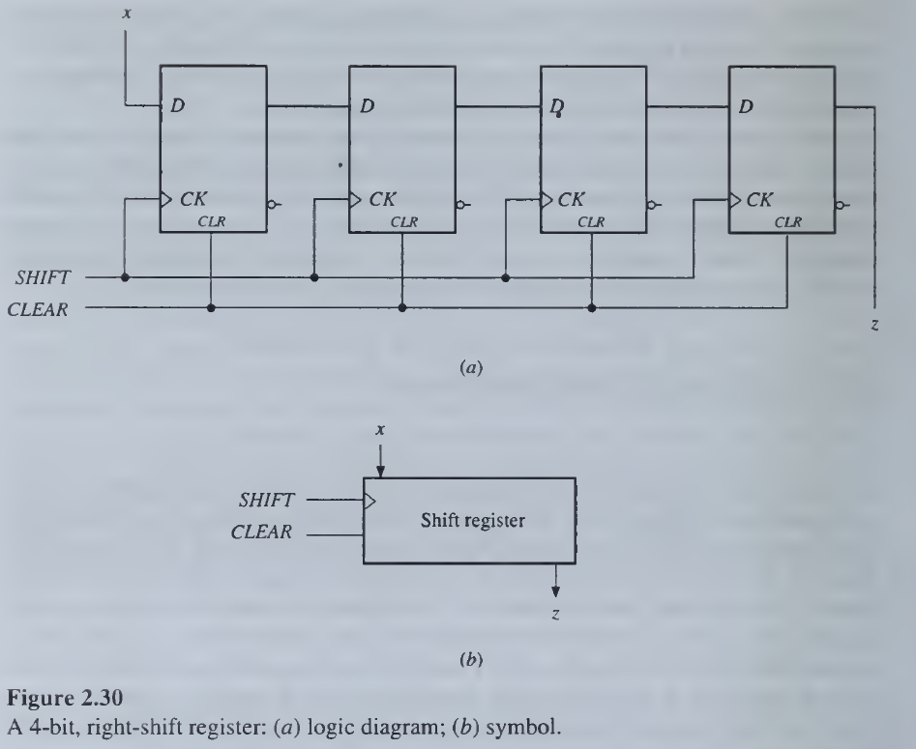
UNIT I - COMPUTING ELEMENTS & DATA REPRESENTATION
REGISTER LEVEL DESIGN

Slide 44
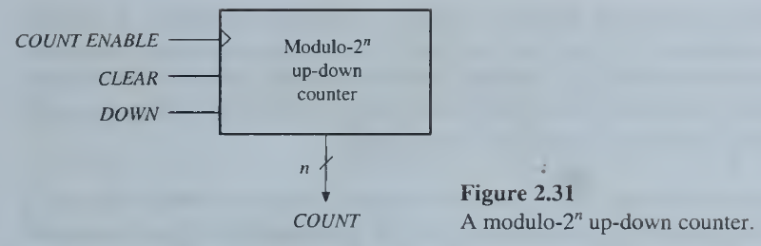
UNIT I - COMPUTING ELEMENTS & DATA REPRESENTATION
REGISTER LEVEL DESIGN

Slide 45
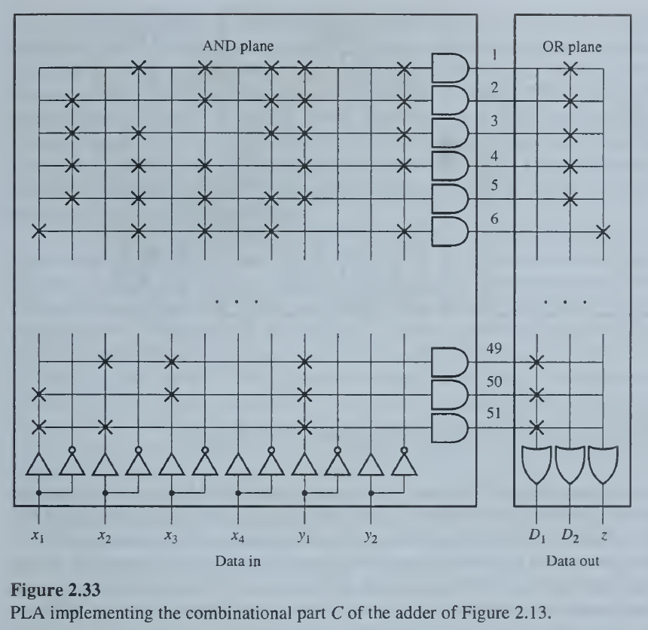
UNIT I - COMPUTING ELEMENTS & DATA REPRESENTATION
REGISTER LEVEL DESIGN
Programmable Logic Devices

Slide 46
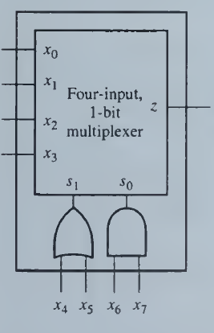
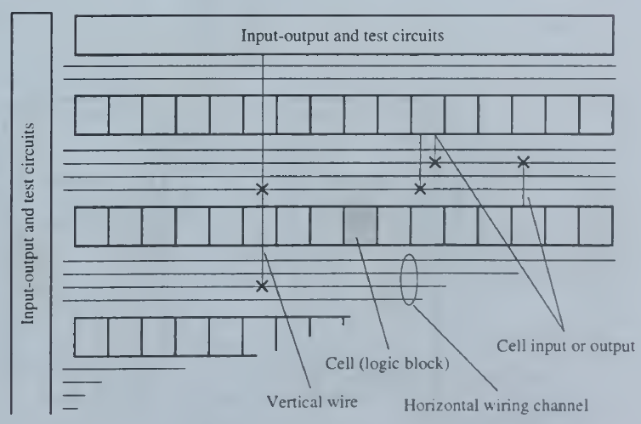
UNIT I - COMPUTING ELEMENTS & DATA REPRESENTATION
REGISTER LEVEL DESIGN
Field Programmable Gate Arrays
Basic cell
Chip Architecture

Slide 47
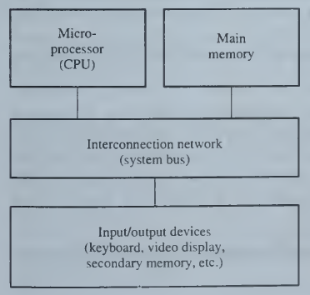
UNIT I - COMPUTING ELEMENTS & DATA REPRESENTATION
PROCESSOR LEVEL DESIGN
Major components of a computer system

Slide 48
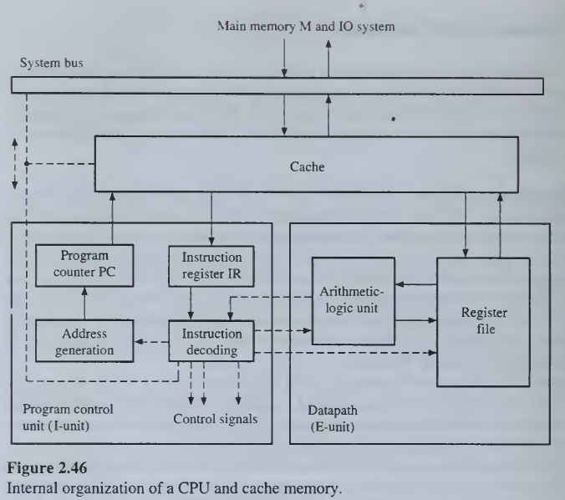
UNIT I - COMPUTING ELEMENTS & DATA REPRESENTATION
PROCESSOR LEVEL DESIGN
Internal organization of a CPU and cache memory

Slide 49
UNIT I - COMPUTING ELEMENTS & DATA REPRESENTATION
PROCESSOR LEVEL DESIGN
Central processing unit:
The CPU contains the logic needed to execute its particular instruction set and is divided into datapath and control units.
The control part (the I-unit) generates the addresses of instructions and data stored in external memory. In this particular system a cache memory is interposed between the main memory M and the CPU.
The cache is a fast buffer memory designed to hold an active portion of the system's address space; it is often placed, wholly or in part, on the same IC as the CPU.
Each memory request generated by the CPU is first directed to the cache. If the required information is not currently assigned to the cache, the request is redirected to M and the cache is automatically updated from M.
The I-unit fetches instructions from the cache or M and decodes them to derive the control signals needed for their execution.
The CPU's datapath (E-unit) has the arithmetic-logic circuits that execute most instructions; it also has a set of registers for temporary data storage.
The CPU manages a system bus, which is the main communication link among the CPU-cache subsystem, main memory, and the IO devices.

Slide 50
UNIT I - COMPUTING ELEMENTS & DATA REPRESENTATION
PROCESSOR LEVEL DESIGN
Central processing unit:
The CPU is a synchronous sequential circuit whose clock period is the computer's basic unit of time.
In one clock cycle the CPU can perform a register-transfer operation, such as fetching an instruction word from M via the system bus and loading it into the instruction register IR.
This operation can be expressed formally by IR := M(PC);
where PC is the program counter the CPU uses to hold the expected address of the next instruction word.
Once in the I-unit, an instruction is decoded to determine the actions needed for its execution; for example, perform an arithmetic operation on data words stored in CPU registers.
The I-unit then issues the sequence of control signals that enables execution of the instruction in question. The entire process of fetching, decoding, and executing an instruction constitutes the CPU's instruction cycle.

Slide 51
UNIT I - COMPUTING ELEMENTS & DATA REPRESENTATION
PROCESSOR LEVEL DESIGN
Memories:
Numerous memory technologies exist, and they vary greatly in cost and performance.
The cost of a memory device generally increases rapidly with its speed of operation.
The memory part of a computer can be divided into several major subsystems:
Main memory M, consisting of relatively fast storage ICs connected directly to, and controlled by, the CPU.
Secondary memory, consisting of less expensive devices that have very high storage capacity. These devices often involve mechanical motion and so are much slower than M. They are generally connected indirectly (via M) to the CPU and form part of the computer's 10 system.
Many computers have a third type of memory called a cache, which is positioned between the CPU and main memory. The cache is intended to further reduce the average time taken by the CPU to access the memory system. Some or all of the cache may be integrated on the same IC chip as the CPU itself.

Slide 52
UNIT I - COMPUTING ELEMENTS & DATA REPRESENTATION
PROCESSOR LEVEL DESIGN
Memories:
Main memory M is a word-organized addressable random-access memory (RAM). The term random access stems from the fact that the access time for every location in M is the same.
Random access is contrasted with serial access, where memory access times vary with the location being accessed.
Serial access memories are slower and less expensive than RAMs; most secondary-memory devices use some form of serial access.
Because of their lower operating speeds and serial access mode, the manner in which the stored information is organized in secondary memories is more complex than the simple word organization of main memory.
Caches also use random access or an even faster memory-accessing method called associative or content addressing.

Slide 53
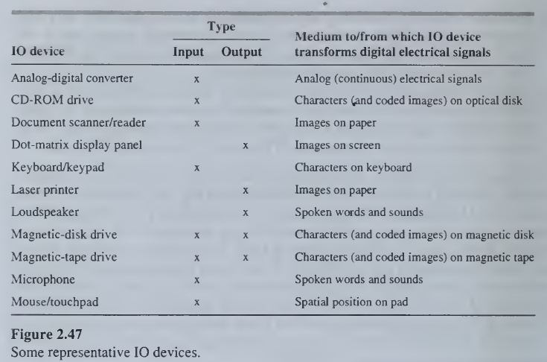
UNIT I - COMPUTING ELEMENTS & DATA REPRESENTATION
PROCESSOR LEVEL DESIGN
IO Devices:
A primary function of 10 devices is to act as data transducers, that is, to convert information from one physical representation to another. Unlike processors, 10 devices do not alter the information content or meaning of the data on which they act.
Since data is transferred and processed within a computer system in the form of digital electrical signals, input (output) devices transform other forms of information to (from) digital electrical signals.

Slide 54
UNIT I - COMPUTING ELEMENTS & DATA REPRESENTATION
PROCESSOR LEVEL DESIGN
Interconnection Networks:
Processor-level components communicate by word-oriented buses.
In systems with many components, communication may be controlled by a subsystem called an interconnection network; terms such as switching network, communications controller, and bus controller are also used in this context.
The function of the interconnection network is to establish dynamic communication paths among the components via the buses under its control.
For cost reasons, these paths are usually shared. Only two communicating devices can access and use a shared bus at any time, so contention results when several system components request use of the bus.
The interconnection network resolves such contention by selecting one of the requesting devices on some priority basis and connecting it to the bus.

Slide 55
UNIT I - COMPUTING ELEMENTS & DATA REPRESENTATION
PROCESSOR LEVEL DESIGN
Interconnection Networks:
Synchronization problem can be attributed to several causes:
A high degree of independence exists among the components. For example, CPUs and IOPs execute different types of programs and interact relatively infrequently and at unpredictable times.
Component operating speeds vary over a wide range. CPUs operate from 1 to 10 times faster than main-memory devices, while main-memory speeds can be many orders of magnitude faster than IO-device speeds.
The physical distance separating the components can be too large to permit synchronous transmission of information between them.

Slide 56
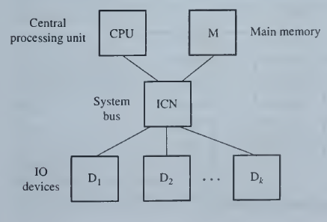
UNIT I - COMPUTING ELEMENTS & DATA REPRESENTATION
PROCESSOR LEVEL DESIGN
Processor Level Design:
Basic computer structure

Slide 57
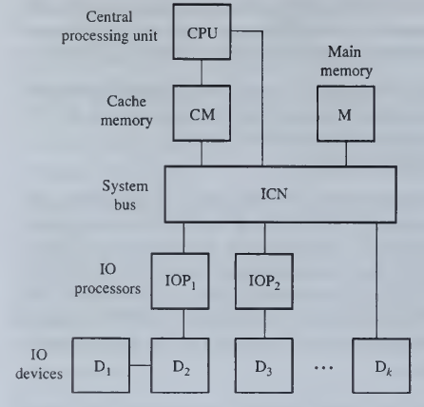
UNIT I - COMPUTING ELEMENTS & DATA REPRESENTATION
PROCESSOR LEVEL DESIGN
Processor Level Design:
Computer with cache and IO processors

Slide 58
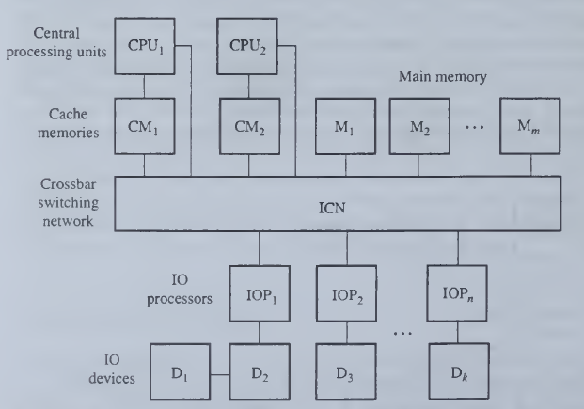
UNIT I - COMPUTING ELEMENTS & DATA REPRESENTATION
PROCESSOR LEVEL DESIGN
Processor Level Design:
Computer with multiple CPUs and main memory banks

Slide 59
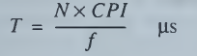
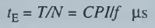
UNIT I - COMPUTING ELEMENTS & DATA REPRESENTATION
PROCESSOR LEVEL DESIGN
Performance measurement:
CPU speed can be measured easily, but roughly, by its clock frequency f in megahertz.
Other, and usually better, performance indicators are MIPS, which is the average instruction execution speed in millions of instructions per second, and CPI, which is the average number of CPU clock cycles required per instruction.
These performance measures are related to the average time T in microseconds (μs) required to execute N instructions by the formula
Hence the average time t_{E} to execute an instruction is

Slide 60

UNIT I - COMPUTING ELEMENTS & DATA REPRESENTATION
PROCESSOR LEVEL DESIGN
Performance measurement:
Another perspective on t_{E} by considering the distribution of instructions of different types and speeds in typical program workloads.
Let I₁, I₂,…, I_{n} be a set of representative instruction types. Let t_{i} denote the average execution time (μs) of an instruction of type I_{i}, and let pi denote the occurrence probability of type I_{i} instructions in representative object code.
Then the average instruction execution time t_{E} is given by

Slide 61

UNIT I - COMPUTING ELEMENTS & DATA REPRESENTATION
PROCESSOR LEVEL DESIGN
Performance measurement:

Slide 62

UNIT I - COMPUTING ELEMENTS & DATA REPRESENTATION
Queuing Model:
The queuing model that we will consider is the single-queue, single-server case depicted in Figure; this is known as the M/M/l model for historical reasons.
It represents a "server" such as a CPU or a computer with a set of tasks (programs) to be executed.
The tasks are activated or arrive at random times and are queued in memory until they can be processed or "serviced" by the CPU on a first come first-served basis.
The key parameters of the model are the rate at which tasks requiring service arrive and the rate at which the tasks are serviced, both measured in tasks/s.
Simple queuing model of a computer
The mean or average arrival and service rates are conventionally denoted by λ (lambda) and μ (mu), respectively.

Slide 63

UNIT I - COMPUTING ELEMENTS & DATA REPRESENTATION
Queuing Model:
Mean Utilization
The symbol ρ (rho) denotes λ/μ and represents the mean utilization of the server, that is, the fraction of time it is busy, on average.
For example, if an average of two tasks arrive per second (λ = 2) and the server can process them at an average rate of eight tasks per second (μ = 8), then ρ = 2/8 = 0.25.
Inter arrival time distribution
The arrival of tasks at the system is a random process characterized by the inter-arrival time distribution p_{I}(t) defined as the probability that at least one task arrives during a period of length t.
The M/M/l case assumes a Poisson arrival process named after the French mathematician Simeon-Denis Poisson (1781-1840) for which the probability distribution is
This exponential distribution has px(t) =0 when t = 0.
As t increases, px(t) increases steadily toward 1 at a rate determined by λ.

Slide 64

UNIT I - COMPUTING ELEMENTS & DATA REPRESENTATION
Queuing Model:
Let p_{s}(t) be the probability that the service required by a task is completed by the CPU in time t or less after its removal from the queue.
Then the service process is characterized by

Slide 65



UNIT I - COMPUTING ELEMENTS & DATA REPRESENTATION
Queuing Model:
Various performance parameters can characterize the steady-state performance of the single-server queuing system under the foregoing assumptions.
The utilization ρ = λ/μ of the server, that is, the average fraction of time it is busy.
The average number of tasks queued in the system, including tasks waiting for service and those actually being served. The parameter is called the mean queue length and is denoted by l_{Q}.
The average time that arriving tasks spend in the system, both waiting for service and being served, which is called the mean waiting time t_{Q}

Slide 66




UNIT I - COMPUTING ELEMENTS & DATA REPRESENTATION
Queuing Model:
Previous Equation is called Little's equation. It is valid for all types of queuing systems, not just the M/M/l model. Combining them, we get
The quantities l_{Q} and t_{Q} refer to tasks that are either waiting for access to the server or are actually being served.
The mean number of tasks waiting in the queue excluding those being served is denoted by l_{w}, while t_{w} denotes the mean time spent waiting in the queue, excluding service time. (The subscript W stands for "waiting.").
The mean utilization of the server in an M/M/l system, that is, the mean number of tasks being serviced, is λ/μ; hence subtracting this from l_{Q} yields l_{w}:

Slide 67
UNIT I - COMPUTING ELEMENTS & DATA REPRESENTATION
Queuing Model:
To illustrate the use of the foregoing formulas, consider a server computer that is processing jobs in a way that can be approximated by the M/M/l model.
Arriving jobs are queued in main memory until they are fully executed in one step by the CPU, which therefore is the server. New jobs arrive at an average rate of 10 per minute, and the computer is, on the average, idle 25 percent of the time.
We ask two questions: What is the average time T that each job spends in the computer? What is the average number of jobs N in main memory that are waiting to begin execution?
To answer, we assume that steady-state conditions prevail, from which it follows that T is t_{Q}, and N is l_{w}.
Since the system is busy 75 percent of the time, ρ = λ/μ = 0.75.
We are given that λ= 10 jobs/min; hence the service rate μ is 40/3 jobs/min.
Substituting yields T= t_{Q} = 1/(40/3 - 10) = 0.3 min.
From Little's equation, N=l_{Q} = λt_{Q} = 3; hence by, l_{w} = 3 - 0.75 = 2.25 jobs

Slide 68
UNIT I - COMPUTING ELEMENTS & DATA REPRESENTATION
CPU ORGANIZATION
Fundamentals
The primary function of the CPU and other instruction-set processors is to execute sequences of instructions, that is, programs, which are stored in an external main memory.
Program execution is therefore carried out as follows:
The CPU transfers instructions and, when necessary, their input data (operands) from main memory to registers in the CPU.
The CPU executes the instructions in their stored sequence except when the execution sequence is explicitly altered by a branch instruction.
When necessary, the CPU transfers output data (results) from the CPU registers to main memory.

Slide 69

UNIT I - COMPUTING ELEMENTS & DATA REPRESENTATION
CPU ORGANIZATION
External communication

Slide 70
UNIT I - COMPUTING ELEMENTS & DATA REPRESENTATION
CPU ORGANIZATION
External communication
The CPU communicates directly with the main memory M, which is typically a high-capacity multichip random-access memory (RAM).
The CPU is significantly faster than M: that is. it can read from or write to the CPU's registers perhaps 5 to 10 times faster than it can read from or write to M. VLSI technology, especially the single-chip microprocessor, has tended to increase the processor/main-memory speed disparity.
To remedy this situation, many computers have a cache memory CM positioned between the CPU and main memory.
The cache CM is smaller and faster than main memory and may reside, wholly or in part, on the same chip as the CPU.
It typically permits the CPU to perform a memory load or store operation in a single clock cycle, whereas a memory access that bypasses the cache and is handled by main memory takes many clock cycles.

Slide 71
UNIT I - COMPUTING ELEMENTS & DATA REPRESENTATION
CPU ORGANIZATION
External communication
The CPU communicates with IO devices in much the same way as it communicates with external memory. The IO devices are associated with addressable registers called IO ports to which the CPU can store a word (an output operation) or from which it can load a word (an input operation).
In some computers there are no IO instructions per se; all IO data transfers are implemented by memory-referencing instructions, an approach called memory-mapped IO. This approach requires that memory locations and IO ports share the same set of addresses, so an address bit pattern that is assigned to memory cannot also be assigned to an IO port, and vice versa.
Other computers employ IO instructions that are distinct from memory-referencing instructions. These instructions produce control signals to which IO ports, but not memory locations, respond. This second approach is sometimes called IO-mapped IO .

Slide 72
UNIT I - COMPUTING ELEMENTS & DATA REPRESENTATION
CPU ORGANIZATION
External communication
Features | Memory Mapped IO | IO Mapped IO
Addressing | IO devices are accessed like any other memory location. | They cannot be accessed like any other memory location.
Address Size | They are assigned with 16-bit address values. | They are assigned with 8-bit address values.
Instructions Used | The instruction used are LDA and STA, etc. | The instruction used are IN and OUT.
Cycles | Cycles involved during operation are Memory Read, Memory Write. | Cycles involved during operation are IO read and IO writes in the case of IO Mapped IO.
Registers Communicating | Any register can communicate with the IO device in case of Memory Mapped IO. | Only Accumulator can communicate with IO devices in case of IO Mapped IO.
Space Involved | 2¹⁶ IO ports are possible to be used for interfacing in case of Memory Mapped IO. | Only 256 I/O ports are available for interfacing in case of IO Mapped IO.
IO/M` signal | During writing or read cycles (IO/M` = 0 ) in case of Memory Mapped IO. | During writing or read cycles (IO/M` = 1) in case of IO Mapped IO.
Control Signal | No separate control signal required since we have unified memory space in the case of Memory Mapped IO. | Special control signals are used in the case of IO Mapped IO.
Arithmetic and Logical operations | Arithmetic and logical operations are performed directly on the data in the case of Memory Mapped IO. | Arithmetic and logical operations cannot be performed directly on the data in the case of IO Mapped IO.

Slide 73
UNIT I - COMPUTING ELEMENTS & DATA REPRESENTATION
CPU ORGANIZATION
User and Supervisor Mode
User or Application program
User or application program handles a specific application, such as word processing, of interest to the computer's users.
Supervisor program
Supervisor program, on the other hand, manages various routine aspects of the computer system on behalf of its users; it is typically part of the computer's operating system.
For example, while executing a user program, the need often arises for information that is available only on some hard disk unit in the computer's IO system. This condition causes the supervisor to temporarily suspend execution of the user program, execute a routine that initiates the required 10 data transfer operation, and then resume execution of the user program.

Slide 74

UNIT I - COMPUTING ELEMENTS & DATA REPRESENTATION
CPU ORGANIZATION
CPU Operation

Slide 75
UNIT I - COMPUTING ELEMENTS & DATA REPRESENTATION
CPU ORGANIZATION
CPU Operation
The sequence of operations performed by the CPU in processing an instruction constitutes an instruction cycle. While the details of the instruction cycle vary with the type of instruction, all instructions require two major steps: a fetch step during which a new instruction is read from the external memory M and an execute step during which the operations specified by the instruction are executed. A check for pending interrupt requests is also usually included in the instruction cycle.
The actions of the CPU during an instruction cycle are defined by a sequence of micro-operations, each of which typically involves a register-transfer operation. The time required for the shortest well-defined CPU micro-operation is the CPU cycle time or clock period T_{clock} and is a basic unit of time for measuring CPU actions.

Slide 76

UNIT I - COMPUTING ELEMENTS & DATA REPRESENTATION
CPU ORGANIZATION
Accumulator based CPU

Slide 77




UNIT I - COMPUTING ELEMENTS & DATA REPRESENTATION
CPU ORGANIZATION
Accumulator based CPU
Fetch operation
Load Instruction
Store Instruction

Slide 78

UNIT I - COMPUTING ELEMENTS & DATA REPRESENTATION
CPU ORGANIZATION
Accumulator based CPU

Slide 79
UNIT I - COMPUTING ELEMENTS & DATA REPRESENTATION
CPU ORGANIZATION
Additional Features
Multipurpose register setfor storing data and addresses:
These replace the accumulator AC and the auxiliary registers DR and AR of our basic CPU. The set of general registers is now usually referred to as a register file.
Additional data, instruction, and address types:
Most CPUs have instructions to handle data and addresses with several different word sizes and formats. Some microprocessors have only add and subtract instructions in the arithmetic category, extra circuitry is required for (fixed-point) multiply and divide instructions, which simplify many programming tasks. Call and return instructions also simplify program design.
Register to indicate computation status:
A status register indicates infrequent or exceptional conditions resulting from the instruction execution. Examples are the appearance of an all-zero result or an invalid instruction like divide by zero.
A status register can also indicate the user and supervisor states. Conditional branch instructions can test the status register, which simplifies the programming of conditional actions.
Program control stack:
Various special registers and instructions facilitate the transfer of control among programs due to procedure calling or external interrupts. Many CPUs use a flexible scheme for program-control transfer, which employs part of the external memory M as a push-down stack

Slide 80

UNIT I - COMPUTING ELEMENTS & DATA REPRESENTATION
CPU ORGANIZATION
Additional Features

Slide 81

UNIT I - COMPUTING ELEMENTS & DATA REPRESENTATION
CPU ORGANIZATION
Pipelining

Slide 82
UNIT I - COMPUTING ELEMENTS & DATA REPRESENTATION
CPU ORGANIZATION
Co-Processors
In general, a coprocessor P is a specialized instruction execution unit that can be coupled to a microprocessor so that instructions to be executed by P can be included in programs fetched by the microprocessor.
Thus the coprocessor serves as an extension to the microprocessor and forms part of the CPU
The 68881 (and the similar but faster 68882) contains a set of eight 80-bit registers for storing floating-point numbers of various formats, including 32- and 64-bit numbers.
They contain command fields specifying floating-point operations that the 68881 can execute. When the 68020 fetches and decodes such an instruction, it transfers the command portion to the coprocessor, which then executes it.
Further exchanges take place between the main processor and the coprocessor until the coprocessor completes execution of its current operation.
The commands executed by the 68881 include the basic arithmetic operations (add. subtract, multiply, and divide), square root, logarithms, and trigonometric functions.

Slide 83

UNIT I - COMPUTING ELEMENTS & DATA REPRESENTATION
CPU ORGANIZATION
Co-Processors

Slide 84

UNIT I - COMPUTING ELEMENTS & DATA REPRESENTATION
DATA REPRESENTATION
Basic Formats

Slide 85

UNIT I - COMPUTING ELEMENTS & DATA REPRESENTATION
DATA REPRESENTATION
Basic Formats

Slide 86


UNIT I - COMPUTING ELEMENTS & DATA REPRESENTATION
DATA REPRESENTATION
Storage Order
Big Endian
Little Endian

Slide 87

UNIT I - COMPUTING ELEMENTS & DATA REPRESENTATION
DATA REPRESENTATION
Storage Order

Slide 88

UNIT I - COMPUTING ELEMENTS & DATA REPRESENTATION
DATA REPRESENTATION
Tags
A few computer designers have argued that the major information types should be assigned formats that identify word.
This can be done by associating with each information word a group of bits, called a tag, that identifies the word's type.
The tag may be considered as a physical implementation of the type declaration found in some high-level programming languages.

Slide 89


UNIT I - COMPUTING ELEMENTS & DATA REPRESENTATION
DATA REPRESENTATION
Error Detection and Correction
Bit c₀ is assigned the value or 1 that makes the number of ones in X* even, in the case of even-parity codes, or odd, in the case of odd-parity codes.
Even-parity
odd-parity

Slide 90

UNIT I - COMPUTING ELEMENTS & DATA REPRESENTATION
DATA REPRESENTATION
Error Detection and Correction
Let c be the number of check bits required to achieve single-error correction with n-bit data words.
Clearly the check bits have 2C patterns that must distinguish between n + c possible error locations and the single error-free case.
Hence c must satisfy the inequality
For n = 16, implies that c > 5,
while for n = 32 we have c > 6.

Slide 91

UNIT I - COMPUTING ELEMENTS & DATA REPRESENTATION
DATA REPRESENTATION
Error Detection and Correction

Slide 92
UNIT I - COMPUTING ELEMENTS & DATA REPRESENTATION
DATA REPRESENTATION
Fixed Point Numbers
In selecting a number representation to be used in a computer, the following factors should be taken into account:
The number types to be represented; for example, integers or real numbers.
The range of values (number magnitudes) likely to be encountered.
The precision of the numbers, which refers to the maximum accuracy of the representation.
The cost of the hardware required to store and process the numbers.
Parameter | Fixed Point | Floating Point
Range of Value | Limited | Larger Range
Cost | Minimum | Maximum
Precision | Low | High

Slide 93
UNIT I - COMPUTING ELEMENTS & DATA REPRESENTATION
DATA REPRESENTATION
Fixed Point Numbers
Binary Number (Unsigned)
Signed Numbers (MSB for Sign Bit)
Sign Magnitude (-75) - 11001011
One’s Complement (-75) - 10110100
Two’s Complement (-75) - 10110101
Decimal Numbers
BCD
ASCII
Excess 3 Code
Hexadecimal Code

Slide 94

UNIT I - COMPUTING ELEMENTS & DATA REPRESENTATION
DATA REPRESENTATION
Fixed Point Numbers

Slide 95


UNIT I - COMPUTING ELEMENTS & DATA REPRESENTATION
DATA REPRESENTATION
Exceptional Conditions
Overflow Detection
If the result of an arithmetic operation involving n-bit numbers is too large (small) to be represented by n bits, overflow (underflow) is said to occur. It is generally necessary to detect overflow and underflow, since they may indicate bad data or a programming error.

Slide 96


UNIT I - COMPUTING ELEMENTS & DATA REPRESENTATION
DATA REPRESENTATION
Exceptional Conditions
Overflow Detection

Slide 97
UNIT I - COMPUTING ELEMENTS & DATA REPRESENTATION
DATA REPRESENTATION
Exceptional Conditions
Round Off Error
A related issue in computer arithmetic is round-off error, which results from the fact that every number must be represented by a limited number of bits.
An operation involving n-bit numbers frequently produces a result of more than n bits.
For example, the product of two Ai-bit numbers contains up to In bits, all but n of which must normally be discarded.
Retaining the ‘n’ most significant bits of the result without modification is called truncation.
Clearly the resulting number is in error by the amount of the discarded digits.
This error can be reduced by a process called rounding.
For instance, to round 0.346712 to three decimal places, add 0.0005 to obtain 0.347212 and then take the three most significant digits 0.347.

Slide 98
UNIT I - COMPUTING ELEMENTS & DATA REPRESENTATION
DATA REPRESENTATION
Floating Point Numbers
it is easier to write a quintillion as
1.0 x 10 ¹⁸
than as the 19-bit, fixed-point integer 1 000 000 000 000 000 000.
Basic formats:
Three numbers are associated with a floating-point number:
A mantissa M
An exponent E, and
A base B.
The mantissa M is also referred to as the significand or fraction in the literature. These three components together represent the real number M x B^{E}
For example, 1.0 is the mantissa, 18 is the exponent, and 10 is the base.

Slide 99
UNIT I - COMPUTING ELEMENTS & DATA REPRESENTATION
DATA REPRESENTATION
Floating Point Numbers
A floating-point number is therefore stored as a word (M,E) consisting of a pair of signed fixed-point numbers: a mantissa M, which is usually a fraction or an integer, and an exponent E, which is an integer.
The number of digits in M determines the precision of (M,E); B and E determine its range.
With a word size of n bits, 2" is the most real numbers that (M,E) can represent.
Increasing B increases the range of the representable real numbers but results in a sparser distribution of numbers over that range.
Example:
Suppose that M and E are both 3-bit, sign-magnitude integers and B = 2. Then M and E can each assume the values ±0, ±1, ±2, and ±3.
All binary words of the form (M,E) = (.x00, xxx) represent zero, where x denotes either 0 or 1.
The smallest nonzero positive number is (001,111), denoting 1 x 2⁻³ = 0.125; (101,111) denotes -0.125.
The largest representable positive number is (011,011), which denotes 3 x 2³ = 24, while (111,011) = -3 x 2³ = -24 denotes the largest negative number -24.
Observe that the left-most bit, which is the sign of the mantissa, is also the sign of the floating-point number.

Slide 100

UNIT I - COMPUTING ELEMENTS & DATA REPRESENTATION
DATA REPRESENTATION
Floating Point Numbers

Slide 101
UNIT I - COMPUTING ELEMENTS & DATA REPRESENTATION
DATA REPRESENTATION
Floating Point Numbers
Limitations:
It cannot represent the number 1.25; it is approximated by (011,101), representing 1.5, or by either (001,000) or (001,100), representing 1.0.
Moreover, the results of most calculations with floating-point arithmetic only approximate the correct result.
For example, in the system, the exact result (18) of the addition (011,001) + (011,010), which implements 6 + 12, is not representable.
The closest representable number, that is, the best approximation to 18, is (010,011) = 16.
Overflow occurs in this small system when a result's magnitude exceeds 24, and
Underflow occurs when a nonzero result has a magnitude less than 0.125.

Slide 102
UNIT I - COMPUTING ELEMENTS & DATA REPRESENTATION
DATA REPRESENTATION
Floating Point Numbers
Normalization and biasing:
Floating-point representation is redundant in the sense that the same number can be represented in more than one way.
For example, 1.0 x 10 ¹⁸, 0.1 x 10 ¹⁹, 1000000 x 10 ¹², and 0.000001 x 10²⁴ are possible representations of a quintillion.
Consider the common case where the mantissa is a sign-magnitude fraction and a base of r is used.
The mantissa is said to be normalized if the digit to the right of the radix point is not zero, that is, no leading zeros appear in the magnitude part of the number.
Thus, for example, 0.1 x 10 ¹⁹ is the unique normal form of a quintillion using base 10, a decimal mantissa, and a decimal exponent.
The representation of zero poses some special problems.
The mantissa must, of course, be zero, but the exponent can have any value, since 0xB^{E} = 0 for all values of E.
Often in attempting to compute zero, round-off errors result in a mantissa that is nearly, but not exactly, zero.
For the entire floating-point number to be close to zero, its exponent must be a very large negative number -K.

Slide 103
UNIT I - COMPUTING ELEMENTS & DATA REPRESENTATION
DATA REPRESENTATION
Floating Point Numbers
Normalization and biasing:
A second complication arises from the desirability of representing zero by a sequence of 0-bits only. This convention gives zero the same representation in both fixed- and floating-point formats, which facilitates the implementation of instructions that test for zero.
These considerations suggest that floating-point exponents should be encoded in excess-K code similar to the excess-three code, where the exponent field E contains an integer that is the desired exponent value plus K.
The quantity K is called the bias, and an exponent encoded in this way is called a biased exponent or characteristic.
Figure 3.25 shows the possible values of an 8-bit exponent with bias 127 and 128.

Slide 104

UNIT I - COMPUTING ELEMENTS & DATA REPRESENTATION
DATA REPRESENTATION
Floating Point Numbers
Normalization and biasing:

Slide 105
UNIT I - COMPUTING ELEMENTS & DATA REPRESENTATION
DATA REPRESENTATION
Floating Point Numbers
IEEE 754 Standard:
Until the 1980s floating-point number formats varied from one computer family to the next, making it difficult to transport programs between different computers without encountering small but significant differences in such areas as round-off errors.
To deal with this problem, the Institute of Electrical and Electronics Engineers (IEEE) sponsored a standard format for 32-bit and larger floating-point numbers, known as the IEEE 754 standard [IEEE 1985]. which has been widely adopted by computer manufacturers.
Besides specifying the permissible formats for M, E, and B, the IEEE standard prescribes methods for handling round-off errors, overflow, underflow, and other exceptional conditions.

Slide 106


UNIT I - COMPUTING ELEMENTS & DATA REPRESENTATION
DATA REPRESENTATION
Floating Point Numbers
IEEE 754 Standard:

Slide 107

UNIT I - COMPUTING ELEMENTS & DATA REPRESENTATION
DATA REPRESENTATION
Floating Point Numbers
Special Case:
If the result of a floating-point operation is not a valid floating-point number, then a special code referred to as not a number (NaN) is used.
Examples of operations that result in NaNs are dividing zero by zero and taking the square root of a negative number. NaN formats are identified in the standard by M≠0, and E = 255 (32-bit format) or E = 2047 (64-bit format).
When overflow occurs, meaning that a number has been produced whose magnitude is too big to represent by the usual format, the result is referred to as infinity, or α, and is identified by M = 0, and E = 255 (32-bit format) or E = 2047 (64-bit format).

Slide 108
UNIT I - COMPUTING ELEMENTS & DATA REPRESENTATION
DATA REPRESENTATION
Floating Point Numbers
Common name | Base | Sign | Exponent | Significand bits or digits | Total | Exponent bits | Exponent bias | E min | E max
Half precision | 2 | 1 | 5 | 11 | 16 | 5 | 2⁴−1 = 15 | −14 | +15
Single precision | 2 | 1 | 8 | 24 | 32 | 8 | 2⁷−1 = 127 | −126 | +127
Double precision | 2 | 1 | 11 | 53 | 64 | 11 | 2¹⁰−1 = 1023 | −1022 | +1023
Quadruple precision | 2 | 1 | 15 | 113 | 128 | 15 | 2¹⁴−1 = 16383 | −16382 | +16383
Octuple precision | 2 | 1 | 19 | 237 | 256 | 19 | 2¹⁸−1 = 262143 | −262142 | +262143

Slide 109


UNIT I - COMPUTING ELEMENTS & DATA REPRESENTATION
INSTRUCTION SETS
Instruction Formats
The purpose of an instruction is to specify both an operation to be carried out by a CPU or other processor and the set of operands or data to be used in the operation.
The operands include the input data or arguments of the operation and the results that are produced.
The operation op is specified by a field called the opcode (operation code). The n X₁, X₂ ,. . ., X_{n} fields are referred to as addresses.
An address X_{i} typically names a register or a memory location that stores an operand value.
In some instances X_{i} itself is the desired value, in which case it is called an immediate address.

Slide 110

UNIT I - COMPUTING ELEMENTS & DATA REPRESENTATION
INSTRUCTION SETS
Instruction Formats
Instruction length in the 680X0 varies from 2 to 10 bytes.

Slide 111



UNIT I - COMPUTING ELEMENTS & DATA REPRESENTATION
INSTRUCTION SETS
Instruction Formats
A variant of the same two-address instruction can also refer to an operand in memory:

Slide 112

UNIT I - COMPUTING ELEMENTS & DATA REPRESENTATION
INSTRUCTION SETS
RISC Formats
Complex instructions lead to several difficulties, which RISCs with their smaller and streamlined instruction sets attempt to minimize.
The many instruction types and formats of a CISC complicate the program control unit that decodes instruction opcodes and issues the control signals that govern their execution. The 68020 employs a large, two-level microprogrammed PCU (Figure 3.11), whereas the ARM6 has a smaller hardwired circuit as its PCU.
Fast, single-cycle instruction execution is harder to achieve with a complex instruction set, and it is more difficult for a compiler to optimize object-code performance.

Slide 113

UNIT I - COMPUTING ELEMENTS & DATA REPRESENTATION
INSTRUCTION SETS
RISC Formats

Slide 114

UNIT I - COMPUTING ELEMENTS & DATA REPRESENTATION
INSTRUCTION SETS
Operand Extension
Numerical operands can be unsigned binary number words, such as memory addresses, or signed data words that employ twos-complement code.
A systematic method is needed to extend short operand values to full-size, signed or unsigned numbers.
When a short w-bit, twos-complement number is used in an n-bit arithmetic operation where n > m, a technique called sign extension is employed.
This techniques replicates the left-most bit s of the short operand N, which corresponds to its
sign bit, n-m times and attaches s^{n-m} = ss... s to the left side of N. Sign extension changes a 13-bit operand
If S=0, then sign extension would precede N by 19 leading 0s.

Slide 115
UNIT I - COMPUTING ELEMENTS & DATA REPRESENTATION
INSTRUCTION SETS
Addressing Modes
The purpose of an address field is to point to the current value V(X) of some operand X used by an instruction.
This value can be specified in various ways, which are termed addressing modes.
The addressing mode of X affects the following issues:
The speed with which V(X) can be accessed by the CPU.
The ease with which V(X) can be specified and altered.

Slide 116
UNIT I - COMPUTING ELEMENTS & DATA REPRESENTATION
INSTRUCTION SETS
Addressing Modes
Immediate addressing
Direct addressing
Indirect addressing
Relative addressing
Register Direct addressing
Register Indirect addressing
Register Indirect with offset addressing
Register Indirect with immediate index addressing
Post Incrementing/Decrementing
Pre Incrementing/Decrementing

Slide 117
UNIT I - COMPUTING ELEMENTS & DATA REPRESENTATION
INSTRUCTION SETS
Addressing Modes – Number of Addresses
Fewer the addresses, the shorter the instruction format needed. However, limiting the number of addresses also limits the range of operations that an instruction can perform.
Roughly, fewer addresses mean more primitive instructions and therefore longer programs to perform a given task.
While the storage requirements of shorter instructions and longer programs tend to balance, larger programs require longer execution times.
On the other hand, long instructions with multiple addresses require more complex decoding and processing circuits.
Zero Address
One Address
Two Address
Three Address

Slide 118

UNIT I - COMPUTING ELEMENTS & DATA REPRESENTATION
INSTRUCTION SETS
Addressing Modes – Number of Addresses
Zero Address

Slide 119

UNIT I - COMPUTING ELEMENTS & DATA REPRESENTATION
INSTRUCTION SETS
Addressing Modes – Number of Addresses
One Address

Slide 120

UNIT I - COMPUTING ELEMENTS & DATA REPRESENTATION
INSTRUCTION SETS
Addressing Modes – Number of Addresses
Two Address

Slide 121

UNIT I - COMPUTING ELEMENTS & DATA REPRESENTATION
INSTRUCTION SETS
Addressing Modes – Number of Addresses
Three Address

Slide 122
UNIT I - COMPUTING ELEMENTS & DATA REPRESENTATION
INSTRUCTION SETS
Instruction Types
The requirements to be satisfied by an instruction set can be stated in the following
It should be complete in the sense that we should be able to construct a machine language program to evaluate any function that is computable using a reasonable amount of memory space.
It should be efficient in that frequently required functions can be performed rapidly using relatively few instructions.
It should be regular in that the instruction set should contain expected opcodes and addressing modes; for example, if there is a left shift, there should be a right shift.
To reduce both hardware and software design costs, the instructions may be required to be compatible with those of existing machines—previous members of the same computer family, for instance.

Slide 123
UNIT I - COMPUTING ELEMENTS & DATA REPRESENTATION
INSTRUCTION SETS
Instruction Types
Instructions are conveniently divided into the following five types:
Data-transfer instructions: which copy information from one location to another either in the processor's internal register set or in the external main memory.
Arithmetic instructions: which perform operations on numerical data.
Logical instructions: which include Boolean and other non-numerical operations.
Program-control instructions: such as branch instructions, which change the sequence in which programs are executed.
Input-output (IO) instructions: which cause information to be transferred between the processor or its main memory and external IO devices.

Slide 124

UNIT I - COMPUTING ELEMENTS & DATA REPRESENTATION
INSTRUCTION SETS
Instruction Types

Slide 125

UNIT I - COMPUTING ELEMENTS & DATA REPRESENTATION
INSTRUCTION SETS
Instruction Types

Slide 126

UNIT I - COMPUTING ELEMENTS & DATA REPRESENTATION
INSTRUCTION SETS
Instruction Types

Slide 127
UNIT I - COMPUTING ELEMENTS & DATA REPRESENTATION
INSTRUCTION SETS
RISC Vs CISC
The major attributes of RISCs have been defined as follows :
Relatively few instruction types and addressing modes.
Fixed and easily decoded instruction formats.
Fast, single-cycle instruction execution.
Hardwired rather than microprogrammed control.
Memory access limited mainly to load and store instructions.
Use of compilers to optimize object-code performance.

